Slide 1


CMR TECHNICAL CAMPUS
UGC AUTONOMOUS
Accredited by NBA & NAAC with ‘A’ Grade
Approved by AICTE, New Delhi and JNTU, Hyderabad
Kandlakoya , Medchal Road, Hyderabad- 501 401, Telangana
Department of Computer Science And Engineering
FAKE PROFILE IDENTIFICATION IN SOCIAL NETWORK USING MACHINE LEARNING AND NLP
MAJOR PROJECT REVIEW
BATCH NO :14
PROJECT GUIDE:
K.SHILPA
(ASSISTANT PROFESSOR)
PRESENTED BY:
K.NIKITHA REDDY 207R1A05F0
B.ABHIRAM 207R1A05C9
JACINTH PHILIP 207R1A05E4

Slide 2
CONTENTS
ABSTRACT
EXISTING SYSTEM
EXISTING SYSTEM DISADVANTAGES
PROPOSED SYSTEM
PROPOSED SYSTEM ADVANTAGES
REQUIREMENTS SPECIFICATION
NOVELTY
ARCHITECTURE
MODULES
UML DIAGRAMS
SAMPLE CODE
RESULTS
CONCLUSION
REFERENCES
FUTURE SCOPE
GITHUB LINK

Slide 3
ABSTRACT
At present social network sites are part of the life for most of the people. Every day several people are creating their profiles on the social network platforms and they are interacting with others independent of the user’s location and time. The social network sites not only providing advantages to the users and also provide security issues to the users as well their information. To analyze, who are encouraging threats in social network we need to classify the social networks profiles of the users. From the classification, we can get the genuine profiles and fake profiles on the social networks. Traditionally, we have different classification methods for detecting the fake profiles on the social networks. But, we need to improve the accuracy rate of the fake profile detection in the social networks. In this paper we are proposing Machine learning and Natural language Processing (NLP) techniques to improve the accuracy rate of the fake profiles detection. We can use the Support Vector Machine (SVM) and Naïve Bayes algorithm.

Slide 4

EXISTING SYSTEM
Current approaches to fake profile identification in social networks primarily rely on rule-based methods.
These methods often involve manual inspection of profile information, activity patterns, and user interactions to flag suspicious accounts.
Lack of scalability and accuracy in identifying sophisticated fake profiles due to reliance on simplistic algorithms.
Challenges in adapting existing systems to evolving tactics employed by malicious actors in creating fake profiles.

Slide 5
EXISTING SYSTEM DISADVANTAGES
Accuracy
Time Consumption
Costliness
Absence of Machine Learning

Slide 6


THE SYSTEM
Integration of Machine Learning & NLP: Develop a system that combines machine learning algorithms and natural language processing techniques for comprehensive analysis of profile data and user interactions.
Utilization of SVM and Naïve Bayes: Implement Support Vector Machine (SVM) and Naïve Bayes algorithms to classify and identify fake profiles based on patterns in profile information, activity, and language usage.
Automated Detection Process: Design an automated detection process to streamline the identification of fake profiles, reducing the need for manual inspection and intervention.
Continuous Improvement: Incorporate mechanisms for continuous learning and improvement, allowing the system to adapt to new tactics employed by malicious actors and enhance detection accuracy over time.

Slide 7
THE SYSTEM ADVANTAGES
Enhanced Accuracy
Reduced Time Consumption
Cost-Effective Solution
Scalable Framework

Slide 8

REQUIREMENTS SPECIFICATION
HARDWARE REQUIREMENTS
Processor : i3 or above
System : Windows
Hard Disk : 20 GB
Ram : 4 GB
SOFTWARE REQUIREMENTS
Operating system : Windows 7 Ultimate
Coding Language : Python
Framework : Django
Designing : HTML, CSS, JavaScript
Data Base : MySQL

Slide 9
NOVELTY
This project innovatively integrates advanced machine learning and natural language processing techniques for robust fake profile detection. Dynamic feature engineering ensures accuracy by extracting relevant profile data dynamically.
An adaptive learning framework continuously evolves detection algorithms based on real-time feedback, enhancing adaptability. A hybrid model architecture combines supervised and unsupervised learning for optimal accuracy with minimal false positives. Innovative privacy-preserving techniques protect user data while enabling effective detection. Real-time capabilities allow immediate identification and response to emerging fake profiles, safeguarding user trust.

Slide 10
LIST OF MODULES
SERVICE PROVIDER
VIEW AND AUTHORIZE USERS
REMOTE USER

Slide 11
MODULES
SERVICE PROVIDER
In this module, the Service Provider has to login by using valid username and password. After login successful he can do some operations such as
Login, Train & Test User Profile Data Sets, View User Profile Trained and Tested Accuracy in Bar Chart, View User Profile Trained and Tested Accuracy Results, View All Profile Identity Prediction, Find and View Profile Identity Prediction Ratio, View User Profile Identity Ratio Results, Download Predicted Data Sets, View All Remote User.

Slide 12
VIEW AND AUTHORIZE USERS
In this module, the admin can view the list of users who all registered. In this, the admin can view the user’s details such as, username, email, address and admin authorizes the users
REMOTE USER
In this module, there are n numbers of users are present. User should register before doing any operations. Once user registers, their details will be stored to the database. After registration successful, he has to login by using authorized username and password. Once Login is successful user will do some operations like Register and Login, Predict Profile Identification Status, View your Profile.

Slide 13
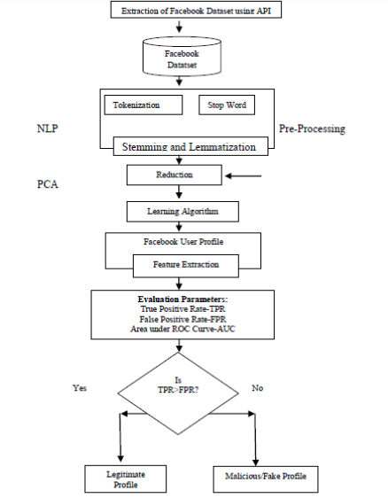
ARCHITECTURE

Slide 14
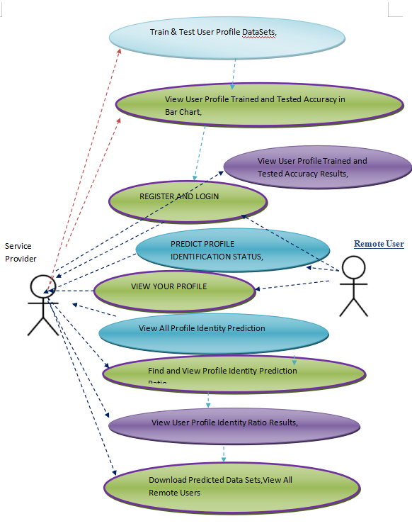
USE CASE DIAGRAM

Slide 15
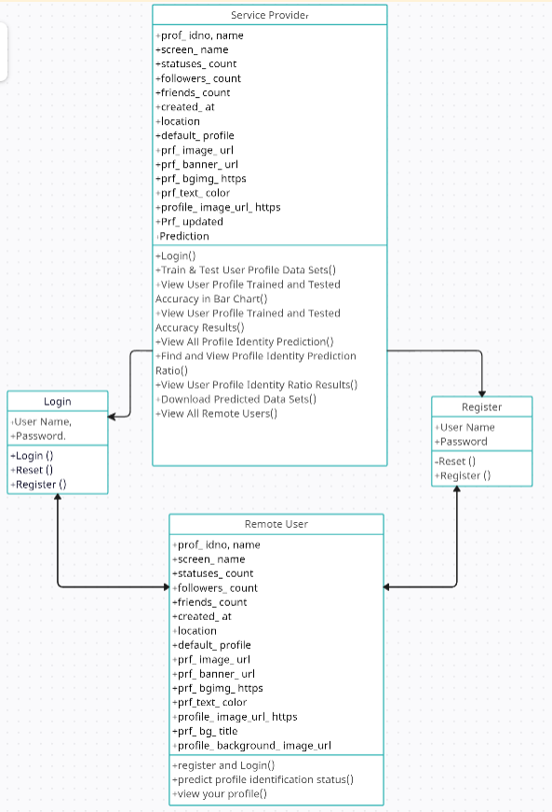
CLASS DIAGRAM

Slide 16
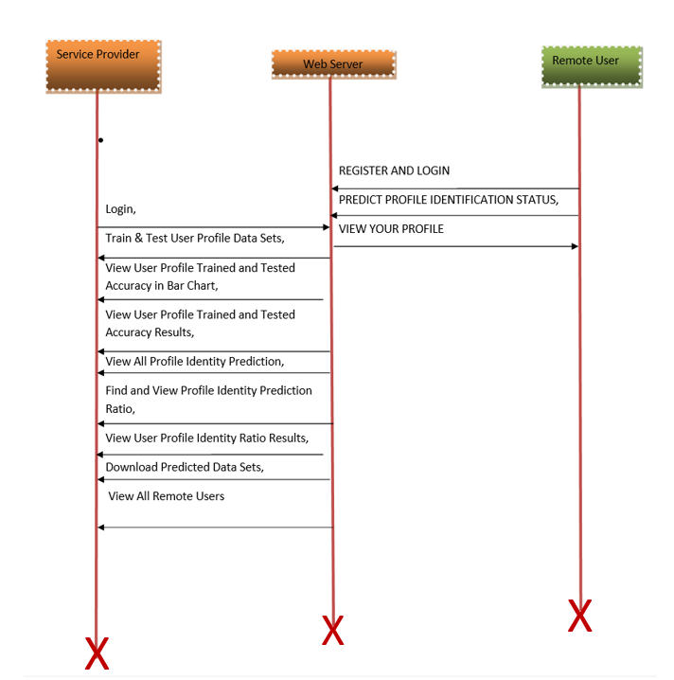
SEQUENCE DIAGRAM

Slide 17
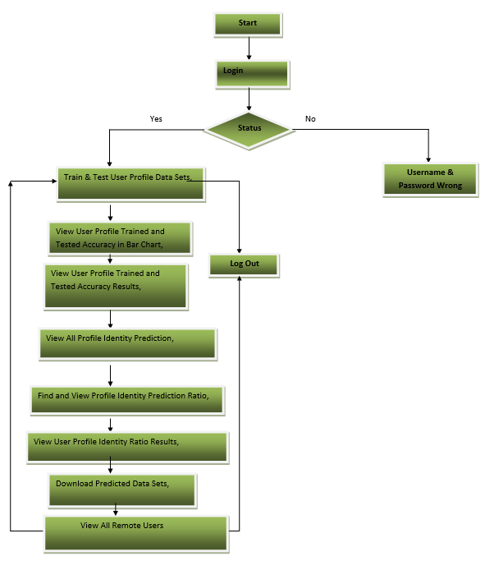
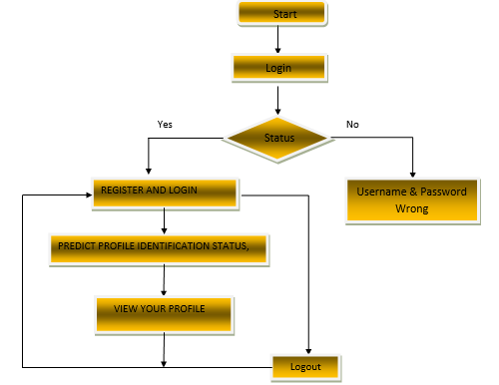
ACTIVITY DIAGRAM
REMOTE USER
SERVICE PROVIDER

Slide 18
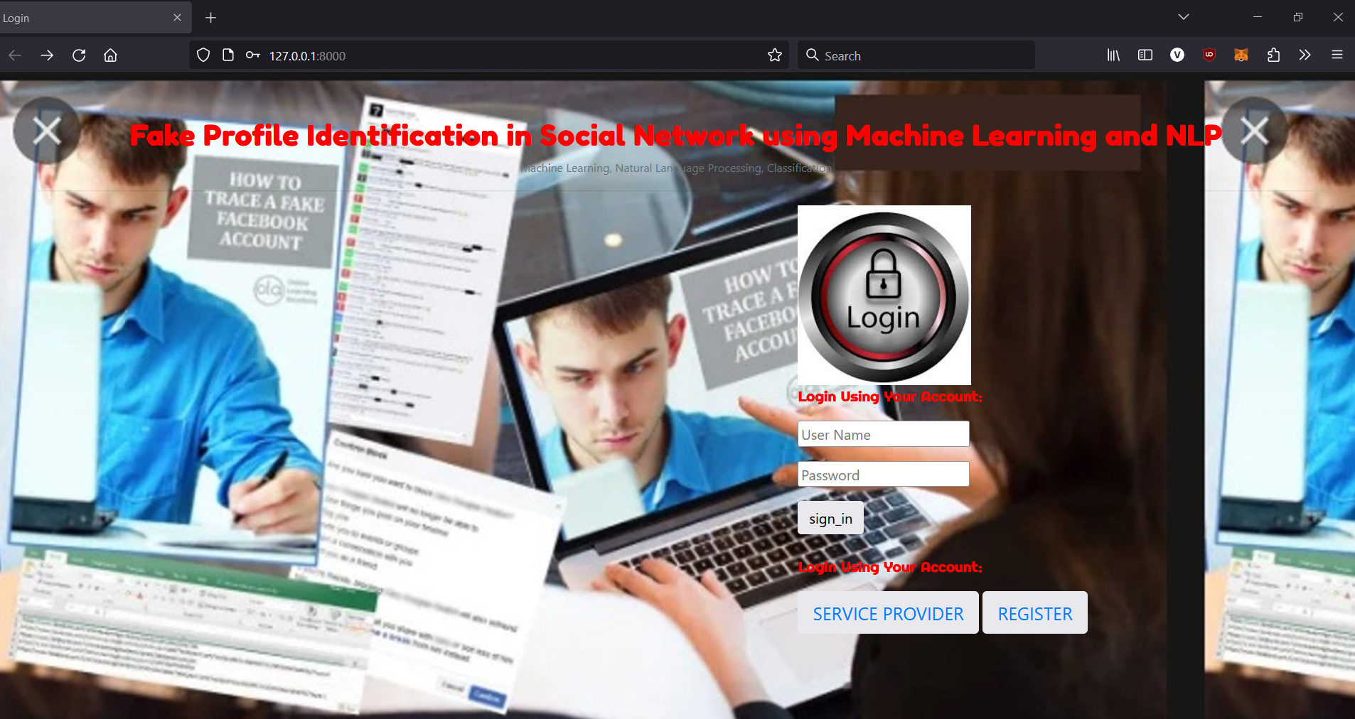
RESULTS

Slide 19
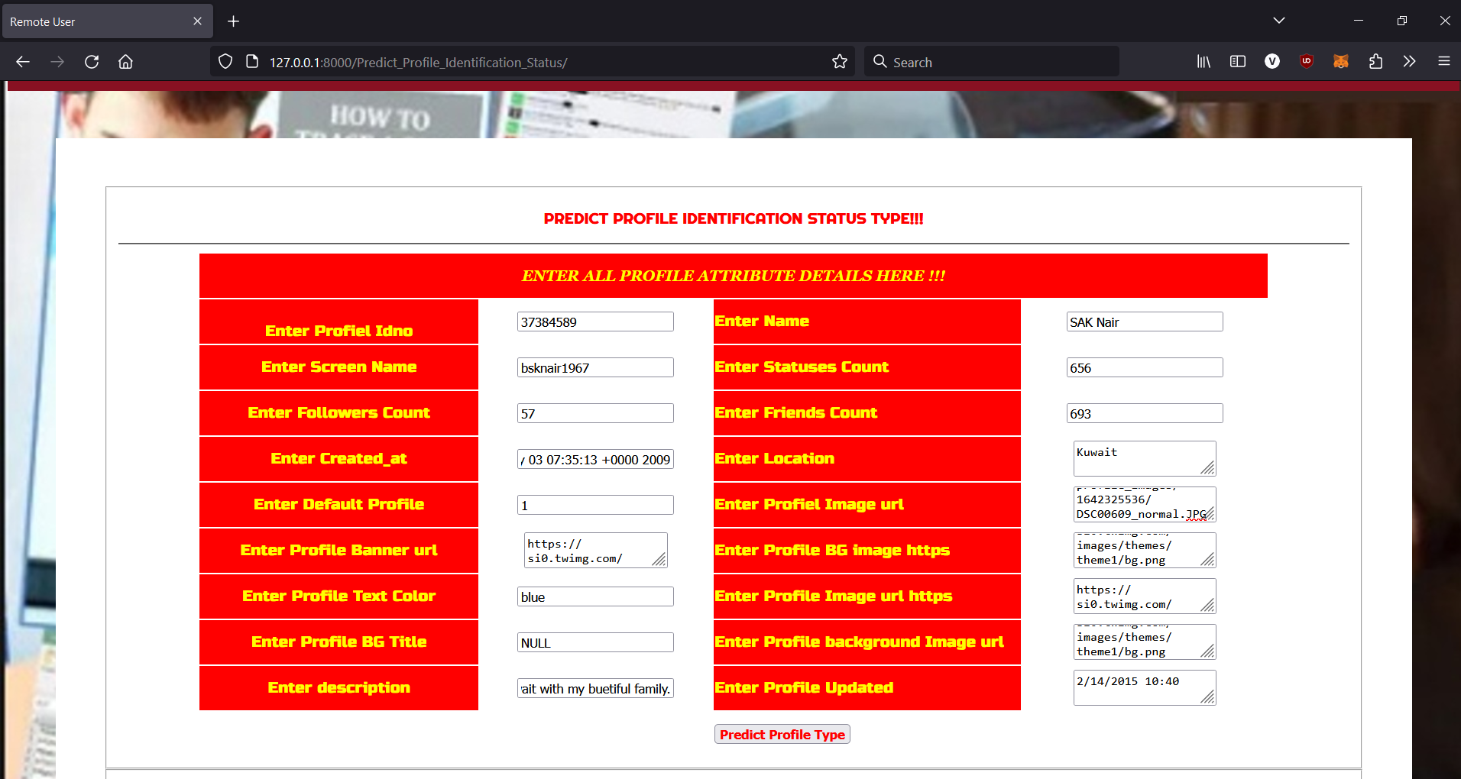

Slide 20
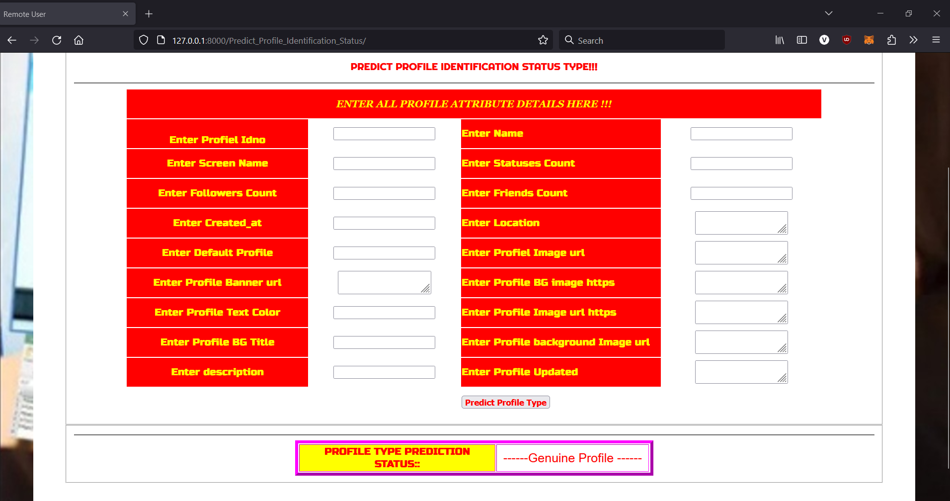

Slide 21
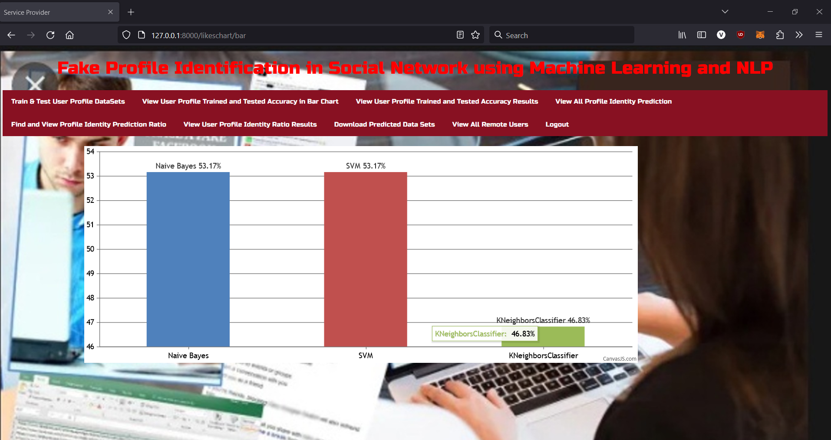

Slide 22
CONCLUSION
In conclusion, employing machine learning (ML) and natural language processing (NLP) techniques for fake profile identification in social networks holds immense promise. By integrating ML algorithms like SVM and Naïve Bayes with NLP methods, we enhance our ability to detect fraudulent profiles with greater accuracy and efficiency. This approach not only improves the overall security and trustworthiness of online platforms but also provides users with a safer and more authentic social networking experience. As we continue to refine and develop these technologies, we move closer to creating a digital environment where users can interact confidently and securely.

Slide 23
REFERENCES
[1] Michael Fire et al. (2012). "Strangers intrusion detection-detecting spammers and fake profiles in social networks based on topology anomalies." Human Journal 1(1): 26-39.Günther, F. and S. Fritsch (2010). "neuralnet: Training of neural networks." The R Journal 2(1): 30-38
[2] Dr. S. Kannan, Vairaprakash Gurusamy, “Preprocessing Techniques for Text Mining”, 05 March 2015.
[3] Shalinda Adikari and Kaushik Dutta, Identifying Fake Profiles in LinkedIn, PACIS 2014 Proceedings, AISeL
[4] Z. Halim, M. Gul, N. ul Hassan, R. Baig, S. Rehman, and F. Naz,“Malicious users’ circle detection in social network based on spatiotemporal co-occurrence,” in Computer Networks and Information Technology (ICCNIT),2011 International Conference on, July, pp. 35–390.
[5] Liu Y, Gummadi K, Krishnamurthy B, Mislove A,” Analyzing Facebook privacy settings: User expectations vs. reality”, in: Proceedings of the 2011 ACM SIGCOMM conference on Internet measurement conference,ACM,pp.61–70.

Slide 24
FUTURE SCOPE
Collaboration with Cybersecurity Frameworks: Collaboration with cybersecurity frameworks will lead to the development of comprehensive solutions that combine fake profile detection with broader security measures, safeguarding users from various online threats.
Adaptation to Emerging Platforms: As new social media platforms and communication mediums emerge, future efforts will focus on adapting fake profile detection techniques to these platforms, ensuring proactive detection and prevention of fraudulent activities across diverse online environments.

Slide 25
GITHUB LINK
https://github.com/nikithareddyk28/indiansignlanguage

Slide 26
THANK YOU

